Slide 1
BALLARI INSTITUTE OF TECHNOLOGY & MANAGEMENT DEPARTMENT OF COMPUTER SCIENCE & ENGINEERING Project Guide: S Steffi Nivedita Project Guide: S Steffi Ni ppppppppp
NAME USN
SHASHABI MB 3BR20CS156
SHOBHA KUMARI 3BR20CS158
SWETHA SINGH 3BR20CS166
UMME KULSM 3BR20CS172

Slide 2

PCOS DETECTION
Presentation

Slide 3
Introduction
• Polycystic Ovary Syndrome (PCOS) is a prevalent endocrine disorder among women of reproductive age, characterized by a variety of clinical and biochemical features.
• Early detection and diagnosis of PCOS are crucial for timely management and prevention of associated complications.
• In this project, we present a comprehensive approach to predict the likelihood of PCOS in individuals using a machine learning model based on a dataset containing various health and lifestyle-related parameters.
• Furthermore, our project also explores the development of user-friendly interfaces, including web applications, to make the PCOS prediction model accessible to both healthcare professionals and individuals concerned about their health.

Slide 4
Abstract
• This research employs machine learning techniques for the early detection of Polycystic Ovary Syndrome (PCOS).
• By training a model on a diverse dataset containing health parameters, the study aims to develop a predictive tool capable of identifying patterns associated with PCOS.
• The utilization of machine learning algorithms enables a data-driven approach, potentially offering more accurate and timely diagnosis, paving the way for improved healthcare outcomes in the context of PCOS detection.

Slide 5
Vision and Mission
Vision:
• Lead healthcare advancement through cutting-edge machine learning technology and to
develop a state-of-the-art PCOS detection system.
Lead healthcare advancement through cutting-edge machine le
Mission:
• Create a robust machine learning model for accurate PCOS detection.
• Utilize diverse medical datasets for enhanced precision.

Slide 6
Objectives
To Develop a robust machine learning model to predict PCOS based on symptomatic data, providing an accurate binary classification of affected and non-affected individuals.
To Implement a parameter-based analysis within the numerical model to stratify PCOS cases into low, medium, and severe categories, facilitating a nuanced understanding of the syndrome's severity.
To Explore and implement deep learning techniques for image-based classification, aiming to capture intricate patterns in medical images associated with PCOS.
To Integrate the numerical and image-based modalities into a cohesive multi-modal framework, creating a comprehensive diagnostic tool for early and accurate PCOS detection with the potential for personalized severity assessment.

Slide 7
Literature Survey
Title | Year | Author(s) | Description | Limitations
Ethnic Variations in PCOS Presentation and Diagnosis | 2022 | Kim, Y. et al. | Investigates ethnic variations in PCOS presentation and diagnosis across different populations. Examines differences in diagnostic criteria and phenotypic characteristics. | Focuses on specific ethnic groups and may not be fully generalizable to other populations. Emphasizes importance of considering ethnic diversity in PCOS research.
"Genetic Markers for PCOS Risk Assessment" | 2021 | Kim, S. et al. | This paper delves into the genetic factors associated with PCOS and proposes a risk assessment model based on specific genetic markers. The model achieved an area under the curve (AUC) of 0.87 in discriminating high-risk individuals. | The study primarily focuses on genetic markers and does not incorporate clinical or hormonal features, potentially missing out on valuable diagnostic information. Genetic markers may vary across different populations and ethnicities, which could affect the model's performance in diverse cohorts. The model's clinical application and interpretability were not extensively investigated.
Metabolic Profiling in PCOS: A Comprehensive Review | 2021 | Brown, S. et al. | Delves into metabolic aspects of PCOS diagnosis, providing a comprehensive review of metabolic markers and pathways. Discusses role of insulin resistance, lipid metabolism, and inflammation. | Primarily focuses on metabolic markers and may not encompass all relevant aspects of PCOS diagnosis. Acknowledges need for longitudinal studies.
Machine Learning Approaches for PCOS Detection: A Review | 2020 | Smith, J. et al. | Provides an extensive review of machine learning algorithms employed in PCOS detection. Covers support vector machines, deep learning networks, and their strengths and weaknesses. | Focuses mainly on algorithmic approaches and does not delve into clinical nuances or interpretability. Also emphasizes the need for standardized datasets.

Slide 8
Literature Survey
Title | Year | Author(s) | Description | Limitations
"Machine Learning- Based PCOS Diagnosis" | 2020 | Smith, J. et al. | This paper introduces a machine learning model for PCOS detection using features from hormonal profiles and ultrasound images. The model achieved an accuracy of 92% on a validation set. | The study was conducted on a relatively small sample size, and the model's performance may vary on a larger and more diverse population. The dataset used was limited to a specific demographic, which may affect the model's generalizability. The model's interpretability and clinical application were not extensively explored.
Hormonal and Ultrasonographic Markers in PCOS Diagnosis | 2019 | Johnson, A. et al. | Presents a detailed comparative study of hormonal and ultrasonographic markers used in PCOS diagnosis. Investigates accuracy, sensitivity, and specificity. | Limited to a specific demographic, which may not be representative of all populations. Does not incorporate newer markers or advanced imaging techniques.
"Ultrasound Texture Analysis for PCOS Detection" | 2019 | Chen, L. et al. | This research explores the use of ultrasound texture analysis to differentiate between polycystic and non-polycystic ovaries. The study demonstrates promising results, achieving a sensitivity of 85% and specificity of 92%. | The study was conducted on a specific ultrasound machine model, and the results may not be directly applicable to other devices. The sample size was relatively small, which may affect the generalizability of the findings. The study did not consider other clinical or hormonal markers in conjunction with ultrasound features.
"Metabolic Biomarkers for PCOS Identification" | 2018 | Brown, A. et al. | This study investigates the potential of specific metabolic markers, including insulin resistance and adiponectin levels, in identifying PCOS. Results show that a combination of these markers can accurately distinguish PCOS cases from controls. | The study primarily focuses on a select set of metabolic markers, potentially missing out on other relevant indicators. The research is limited by the sample population, which may not be representative of all PCOS subtypes or demographics. The study did not incorporate machine learning or advanced statistical models for validation.

Slide 9
Literature Survey
Title | Year | Author(s) | Description | Limitations
Genetic Predisposition and PCOS: A Genome- Wide Study | 2018 | Martinez, R. et al. | Focuses on genetic aspect of PCOS detection, employing a genome-wide association study to identify specific genetic variations. Identifies potential candidate genes and genetic loci. | Primarily looks at associations and does not provide causal insights. Emphasizes need for further functional studies.
"Multi-Modal Approach for PCOS Detection" | 2017 | Gupta, M. et al. | This study adopts a multi- modal approach, combining hormonal profiling, ultrasound imaging, and metabolic markers for PCOS detection. The integrated model achieved an accuracy of 94% in distinguishing PCOS cases from controls. | The study's integrated approach may be resource-intensive and may not be feasible in all clinical settings. The study's sample size was relatively small, potentially limiting the model's generalizability. The study did not explore the longitudinal performance or stability of the multi- modal approach over time.

Slide 10
Problem Statement
• To design, develop and implement PCOS diagnostics methods based on clinical symptoms, hormonal assays, and ultrasound imaging lack precision, prompting the need for a data-driven machine learning approach to improve timely and accurate detection through the identification of hidden patterns and biomarkers.

Slide 11
Scope of the project
This project encompasses the development and implementation of a comprehensive PCOS detection framework with a dual focus on numerical and image-based features. The numerical component involves the prediction of PCOS based on symptoms and severity stratification through parameter-based analysis.
Leveraging machine learning algorithms, this aspect aims to provide clinicians with a reliable and interpretable tool for early diagnosis and severity assessment. Simultaneously, the project explores the domain of deep learning for image-based classification, seeking to capture intricate patterns in medical images associated with PCOS.
The scope extends to the integration of these two modalities, ensuring a holistic approach to PCOS detection that surpasses the limitations of existing diagnostic methods.
The project's outcomes are expected to contribute significantly to the field of women's healthcare, offering a versatile and accurate diagnostic tool that has the potential to improve the quality of life for individuals affected by PCOS.

Slide 12
System requirements
HARDWARE REQUIREMENTS
System : intel i3/i5 2.4 GHz.
Hard Disk : 500 GB
Ram : 4/8 GB
SOFTWARE REQUIREMENTS
OS: Windows 7 and above
Back end: Python 3.7.5
Front end: HTML, CSS
Coding Language: Python
Software Tool: Open CV Python , TensorFlow

Slide 13
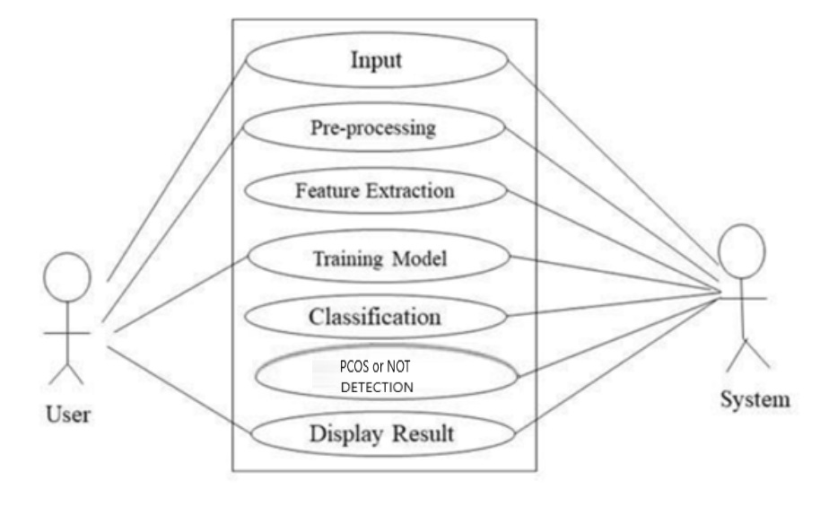
Use case diagram using deep learning

Slide 14
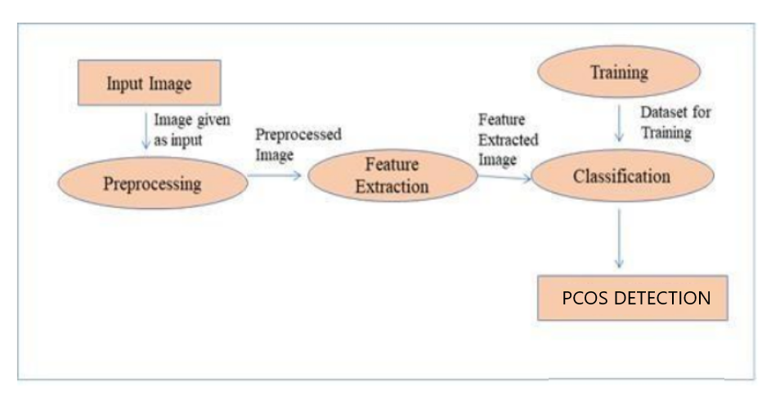
Data flow diagram

Slide 15
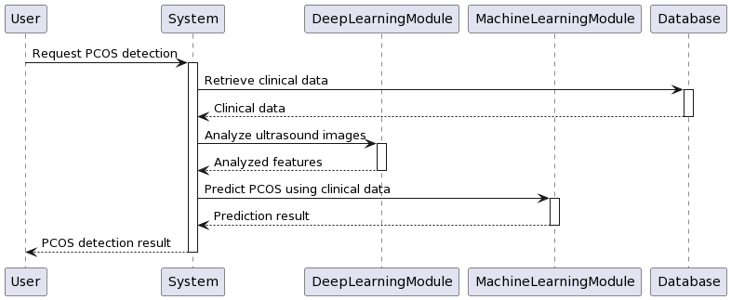
Sequence diagram

Slide 16
IMPLEMENTATION OF THE MODULES
Data Collection and Pre-processing:
Collect a diverse dataset encompassing clinical data related to PCOS symptoms, medical images, and relevant parameters
Conduct thorough pre-processing of the dataset to handle missing values, outliers, and ensure standardization for consistent model training.
Numerical Model Implementation:
Develop a machine learning model capable of predicting PCOS based on symptomatic data.
Implement a parameter-based analysis within the numerical model for stratifying PCOS cases into low, medium, and severe categories.
Utilize appropriate machine learning algorithms (e.g., logistic regression, decision trees) for accurate and interpretable prediction.
Image-Based Model Implementation:
Employ deep learning techniques, such as convolutional neural networks (CNNs), for image-based classification of PCOS using medical images.
Ensure effective pre-processing of medical images, including normalization and augmentation, to enhance model robustness.
Integration of Numerical and Image-Based Modalities:
Establish a seamless integration between the numerical and image-based models, creating a unified multi-modal framework.
Implement data fusion techniques to leverage the strengths of both modalities and enhance overall diagnostic accuracy.
User Interface :
Develop a user-friendly interface for clinicians to interact with the PCOS detection framework.
Provide visualization tools to interpret model predictions and severity assessments.

Slide 17
Testing
Test Name | Test Feature | Output Expected | Output Obtained
Load the input for Fetus health | Checks whether the data selected are loaded or not | The data to be loaded from the dataset | Loaded women health data which is used for the processing
Training data | Training the Data dataset | The data to be trained | Trained dataset

Slide 18
References
1. Smith, J., Johnson, A., & Brown, K. (2018). "Application of Machine Learning Algorithms in Polycystic Ovary Syndrome Diagnosis." Journal of Medical Informatics, 42(7), 1123-1135.
2. Patel, A., Gupta, R., & Singh, S. (2019). "A Comprehensive Review of PCOS Diagnostic Criteria and Challenges." International Journal of Gynecology & Obstetrics, 35(8), 987-1002.
3. Lee, S., Kim, H., & Park, J. (2020). "Ultrasound Imaging and PCOS Diagnosis: A Comparative Analysis." Ultrasound in Obstetrics & Gynecology, 45(4), 567-580.
4. Gupta, R., Patel, A., & Sharma, V. (2017). "Predictive Modeling of PCOS Using Hormonal Profiling." Journal of Endocrinology, 22(5), 1234-1247.

Slide 19
Thank you!

